Slide 1
SWE4005- Storage Technology and Management
Business continuity

Slide 2
Backup and Recovery
Upon completion of this module, you will be able to:
Describe best practices for planning Backup and Recovery.
Describe the common media and types of data that are part of a Backup and Recovery strategy.
Describe the common Backup and Recovery topologies.
Describe the Backup and Recovery Process.
Describe Management considerations for Backup and Recovery.

Slide 3
What is a Backup?
Backup is an additional copy of data that can be used for restore and recovery purposes.
The Backup copy is used when the primary copy is lost or corrupted.
This Backup copy can be created as a:
Simple copy (there can be one or more copies)
Mirrored copy (the copy is always updated with whatever is written to the primary copy.)
Notes:
A Backup is a copy of the online data that resides on primary storage. The backup copy is created and retained for the sole purpose of recovering deleted, broken, or corrupted data on the primary disk.
The backup copy is usually retained over a period of time, depending on the type of the data, and on the type of backup. There are three derivatives for backup: disaster recovery, Archival, and operational backup. We will review them in more detail, on the next slide.
The data that is backed up may be on such media as disk or tape, depending on the backup derivative the customer is targeting. For example, backing up to disk may be more efficient than tape in operational backup environments.

Slide 4
Backup and Recovery Strategies
Several choices are available to get the data to the backup media such as:
Copy the data.
Mirror (or snapshot) then copy.
Remote backup.
Copy then duplicate or remote copy.
Notes:
Several choices are available to get the data written to the backup media.
You can simply copy the data from the primary storage to the secondary storage (disk or tape), onsite. This is a simple strategy, easily implemented, but impacts the production server where the data is located, since it will use the server’s resources. This may be tolerated on some applications, but not high demand ones.
To avoid an impact on the production application, and to perform serverless backups, you can mirror (or snap) a production volume. For example, you can mount it on a separate server and then copy it to the backup media (disk or tape). This option will completely free up the production server, with the added infrastructure cost associated with additional resources.
Remote Backup, can be used to comply with offsite requirements. A copy from the primary storage is done directly to the backup media that is sitting on another site. The backup media can be a real library, a virtual library or even a remote filesystem.
You can do a copy to a first set of backup media, which will be kept onsite for operational restore requirements, and then duplicate it to another set of media for offsite purposes. To simplify thr procedure, you can replicate it to an offsite location to remove any manual procedures associated with moving the backup media to another site.

Slide 5
It’s All About Recovery!
Businesses back up their data to enable its recovery in case of potential loss.
Businesses also back up their data to comply with regulatory requirements.
Types of backup derivatives:
Disaster Recovery
Archival
Operational
Notes:
Disaster Recovery addresses the requirement to be able to restore all, or a large part of, an IT infrastructure in the event of a major disaster.
Archival is a common requirement used to preserve transaction records, email, and other business work products for regulatory compliance. The regulations could be internal, governmental, or perhaps derived from specific industry requirements.
Operational is typically the collection of data for the eventual purpose of restoring, at some point in the future, data that has become lost or corrupted.

Slide 6
Reasons for a Backup Plan
Hardware Failures
Human Factors
Application Failures
Security Breaches
Disasters
Regulatory and Business Requirements
Notes:
Reasons for a backup plan include:
Physical damage to a storage element (such as a disk) that can result in data loss.
People make mistakes and unhappy employees or external hackers may breach security and maliciously destroy data.
Software failures can destroy or lose data and viruses can destroy data, impact data integrity, and halt key operations.
Physical security breaches can destroy equipment that contains data and applications.
Natural disasters and other events such as earthquakes, lightning strikes, floods, tornados, hurricanes, accidents, chemical spills, and power grid failures can cause not only the loss of data but also the loss of an entire computer facility. Offsite data storage is often justified to protect a business from these types of events.
Government regulations may require certain data to be kept for extended timeframes. Corporations may establish their own extended retention policies for intellectual property to protect them against litigation. The regulations and business requirements that drive data as an archive generally require data to be retained at an offsite location.

Slide 7
How does Backup Work?
Client/Server Relationship
Server
Directs Operation
Maintains the Backup Catalog
Client
Gathers Data for Backup (a backup client sends backup data to a backup server or storage node).
Storage Node
Notes:
Backup products vary, but they do have some common characteristics. The basic architecture of a backup system is client-server, with a backup server and some number of backup clients or agents. The backup server directs the operations and owns the backup catalog (the information about the backup). The catalog contains the table-of-contents for the data set. It also contains information about the backup session itself.
The backup server depends on the backup client to gather the data to be backed up. The backup client can be local or it can reside on another system, presumably to backup the data visible to that system. A backup server receives backup metadata from backup clients to perform its activities.
There is another component called a storage node. The storage node is the entity responsible for writing the data set to the backup device. Typically there is a storage node packaged with the backup server and the backup device is attached directly to the backup server’s host platform. Storage nodes play an important role in backup planning as it can be used to consolidate backup servers.

Slide 8
How does Backup Work, continued
Clients
Servers
Backup Clients
Backup Server & Storage Node
Metadata Catalog
Data Set
Disk Storage
Tape Backup
Notes:
The following represents a typical Backup process:
The Backup Server initiates the backup process (starts the backup application).
The Backup Server sends a request to a server to “send me your data”.
The server sends the data to the Backup Server and/or Storage Node.
The Storage Node sends the data to the tape storage device and the Backup Server begins building the catalog (metadata) of the backup session.
When all of the data has been transferred from the server to the Backup Server, the Backup Server writes the catalog to a disk file and closes the connection to the tape device.

Slide 9
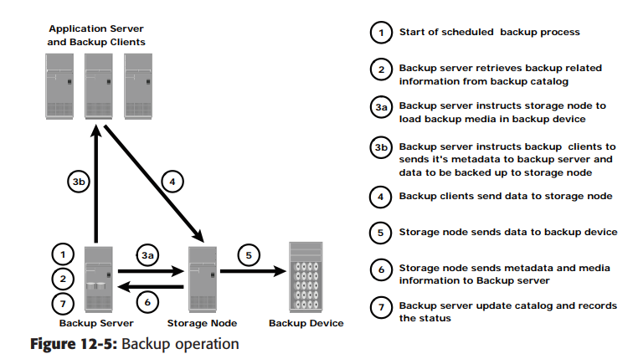
Backup Operation

Slide 10
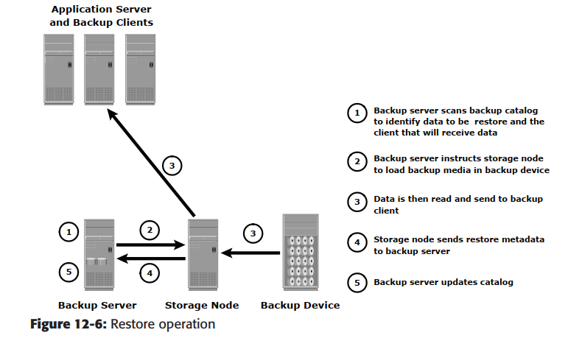
Recovery Operation

Slide 11
Business Considerations
Customer business needs determine:
What are the restore requirements – RPO & RTO?
Where and when will the restores occur?
What are the most frequent restore requests?
Which data needs to be backed up?
How frequently should data be backed up?
hourly, daily, weekly, monthly
How long will it take to backup?
How many copies to create?
How long to retain backup copies?
Notes:
Some important decisions that need consideration before implementing a Backup/Restore solution are shown above. Some examples include:
The Recovery Point Objective (RPO)
The Recovery Time Objective (RTO)
The media type to be used (disk or tape)
Where and when the restore operations will occur – especially if an alternative host will be used to receive the restore data.
When to perform backups.
The granularity of backups – Full, Incremental or cumulative.
How long to keep the backup – for example, some backups need to be retained for 4 years, others just for 1 month
Is it necessary to take copies of the backup or not

Slide 12
Data Considerations: File Characteristics
Location
Size
Number
Notes:
Location: Many organizations have dozens of heteroge neous platforms that support a complex application. Consider a data warehouse where data from many sources is fed into the warehouse. When this scenario is viewed as “The Data Warehouse Application”, it easily fits this model. Some of the issues are:
How the backups for subsets of the data are synchronized
How these applications are restored
Size: Backing up a large amount of data that consists of a few big files may have less system overhead than backing up a large number of small files. If a file system contains millions of small files, the very nature of searching the file system structures for changed files can take hours, since the entire file structure is searched.
Number: a file system containing one million files with a ten-percent daily change rate will potentially have to create 100,000 entries in the backup catalog. This brings up other issues such as:
How a massive file system search impacts the system
Search time/Media impact
Is there an impact on tape start/stop processing?

Slide 13
Data Considerations: Data Compression
Compressibility depends on the data type, for example:
Application binaries – do not compress well.
Text – compresses well.
JPEG/ZIP files – are already compressed and expand if compressed again.
Notes:
Many backup devices such as tape drives, have built-in hardware compression technologies. To effectively use these technologies, it is important to understand the characteristics of the data. Some data, such as application binaries, do not compress well. Text data can compress very well, while other data, such as JPEG and ZIP files, are already compressed.

Slide 14
Data Considerations: Retention Periods
Operational
Data sets on primary media (disk) up to the point where most restore requests are satisfied, then moved to secondary storage (tape).
Disaster Recovery
Driven by the organization’s disaster recovery policy
Portable media (tapes) sent to an offsite location / vault.
Replicated over to an offsite location (disk).
Backed up directly to the offsite location (disk, tape or emulated tape).
Archiving
Driven by the organization’s policy.
Dictated by regulatory requirements.
Notes:
As mentioned before, there are three types of backup models (Operational, Disaster Recovery, and Archive). Each can be defined by its retention period. Retention Periods are the length of time that a particular version of a dataset is available to be restored.
Retention periods are driven by the type of recovery the business is trying to achieve:
For operational restore, data sets could be maintained on a disk primary backup storage target for a period of time, where most restore requests are likely to be achieved, and then moved to a secondary backup storage target, such as tape, for long term offsite storage.
For disaster recovery, backups must be done and moved to an offsite location.
For archiving, requirements usually will be driven by the organization’s policy and regulatory conformance requirements. Tapes can be used for some applications, but for others a more robust and reliable solution, such as disks, may be more appropriate.

